Slide 1
A.D. 2020

Slide 2
René van Schalkwijk BA MA MscBA MME
General Secretary Euprovet
Member of the Board
Horizon College

Slide 3
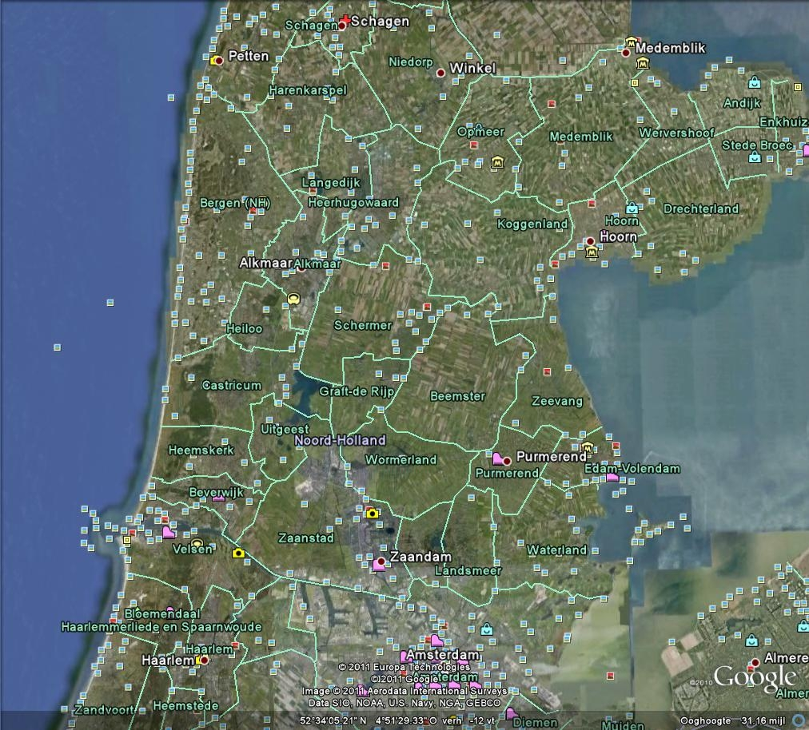

Slide 4
Horizon College
Staff 1000 full time equivalents
Students 12000 in VET
Students 1000 in Adult Education
Turnover 85 mln Euros
IIP and EFQM certified
Top Ten College in NL (73% QR)

Slide 5
EU VET Providers
Euprovet
Efvet
EVTA
EVBB
EURASHE
EUCEN
VET4EU

Slide 6
Education in Europe
The key to the future
Too many low skilled workers
Unused human capital
Preparing for the grey wave
Knowledge is globally fluid
Competent labour force increasingly essential

Slide 7
Knowledge to Competence
Almost every education is Vocational
Labor market relevance important and more difficult
Awareness of Dual labor market development
Permeability, progression and life long learning

Slide 8
The future of education
Integration head heart hands
Away from school work pension
Dual education to trial education
More not less (Oivallus)
Stronger structured efficiency hand in hand with Illich

Slide 9
AD missing link?
PISA
PIAAC
ELLI
EQF
ECVET
ECTS

Slide 10
Ad stepping stone
Mostly dual pathway students (NL 45-10)
Link to extended stepping stone education
Pathway for late developers
Pathway for structured dual higher education
Loosely coupled systems for future flexibility

Slide 11
Value for VET
Way up
Higher value on profesionalism
Stronger continued workplace connection
More years in education (1 year longer 1.8%increase in growth)

Slide 12
Ad risk
Complexity
Comparability
Competition
Complacency
Country

Slide 13
No risk no fun!
Lets work together
Thank you for your attention

