Slide 2
From Level 4 to Level 5 to level 6
– Does It Work in Poland? Europe?
Katarzyna Olszewska, PhD
University of Applied Sciences in Elbląg, POLAND
VET Expert, National VET Team, Foundation for the Development of the Education System
CHAIN5
The Annual Conference 2025
Maia, Portugal 12.11.-14.11.2025 r.

Slide 3
WHERE AM I FROM?

Slide 4


Slide 5
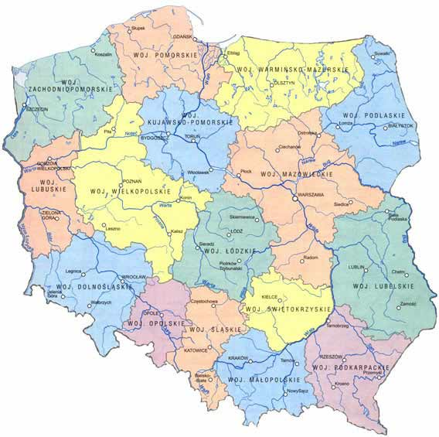
City of Elbląg
located in the northern part of Poland,
60 km south-east of Gdańsk,
300 km north of Poland’s capital Warsaw.
Gdańsk
Elbląg
Warsaw

Slide 6
POLISH EDUCATION

Slide 7


Ministry
of National Education
Ministry of Science and Higher Education
General Education System Management
Teacher Qualifications & Career Pathways
Educational Standards & School Supervision
Vocational & Special Education
Student Welfare & Equal Access to Education
Higher Education Management
Scientific Research & Innovation
Academic Staff & Career Development
International Cooperation & Recognition
Technological Development & Innovation

Slide 8



Polish education
Public primary, secondary schools and studies
are FREE OF CHARGE.
System of external examinations
Central and Regional Examination Boards

Slide 9
THE POLISH EDUCATION SYSTEM

Slide 10
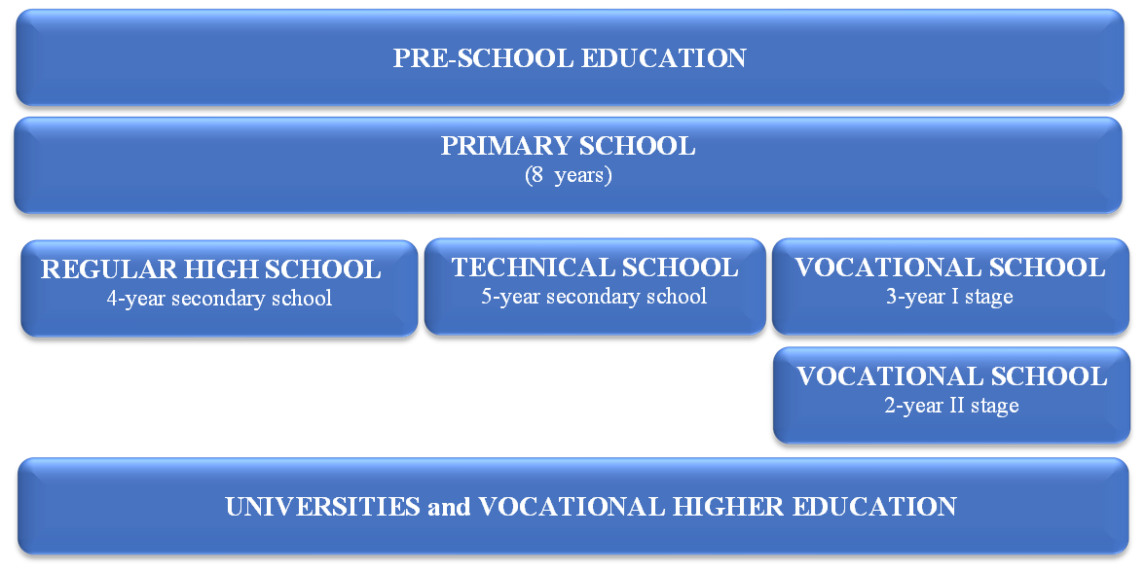

Slide 11
SECONDARY EDUCATION
Education in Poland is compulsory up to the age of 18.

Slide 12
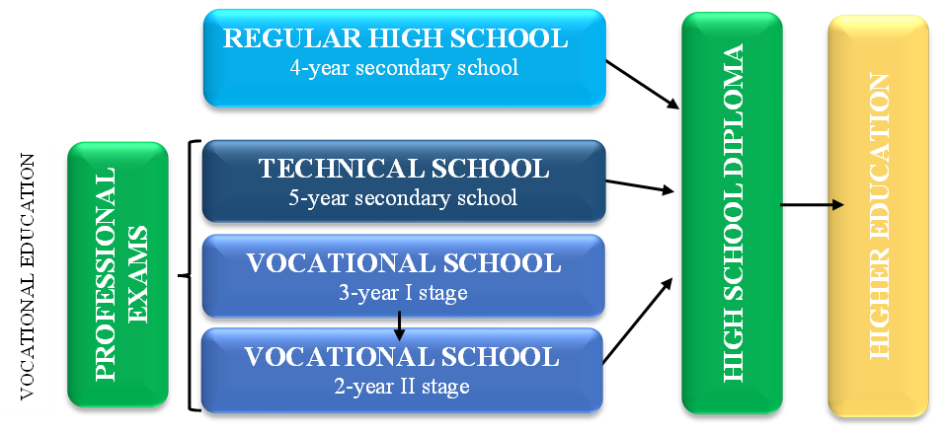

Slide 13
HIGHER EDUCATION

Slide 14
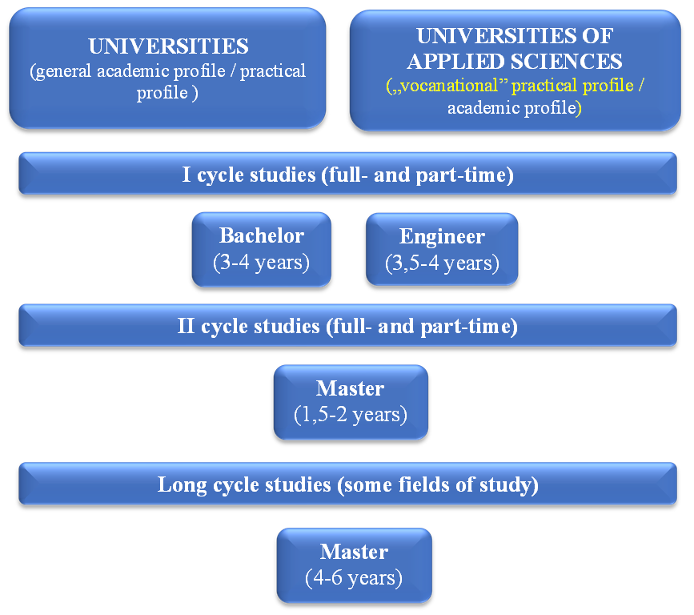

Slide 15
QUALITY OF (VOCATIONAL) EDUCATION

Slide 16


Professional exams
50% theoretical
75% practical
Centres of Vocational Excellence
Accreditation of majors by industry organizations
Response to labor market needs
Cooperation with employers
Źródło: www.smartcaluae.com/main/index.php/quality
Management control - internal educational quality systems
Cooperation with universities
- ACADEMIC CLASSES

Slide 17
EDUCATION SYSTEM FOR ADULTS

Slide 18

General Education
Where?
Flexible learning
Who can apply?
Adult Primary Schools – for those without a basic education
Adult Secondary Schools – allows to get a high school diploma and preapare for the Matura exam
Evening & weekend classes
Distance learning options (e-learning)
People aged 18+ who didn’t complete primary or secondary school
https://www.cypresscollege.edu/

Slide 19

Vocational Education & Training
Level 5 ????
Types of programs
Who can apply?
Benefits
Vocational Qualification Courses – allows adults to gain certificates in specific job skills (e.g., electrician, chef, IT specialist),
Post-secondary Vocational Schools – for those who finished high school but want a technical or medical specialization (e.g., paramedic, dental assistant),
Centers of Vocational Excellence (CoVEs) – for pupils, students, adults, teachers to gain certificates (microcredentianls) in specific job skills
Adults who want to learn a new profession or upgrade their qualifications
No age limit – open to career changers, unemployed individuals, or working professionals
Fast-track career changes
Recognized certifications & diplomas improve job opportunities
Many programs are free or co-financed by the government & EU
https://www.locomotivation.co.uk

Slide 20

POLISH QUALIFICATIONS
FRAMEWORK (PQF)
EUROPEAN QUALIFICATIONS FRAMEWORK (EQF)

Slide 21
PQF = EQF
The EQF is a framework to which national qualification levels relate.
POLAND
EQF levels
Doctoral degree
Level 8
Level 8
Master degree
Level 7
Level 7
Bachelor degree
Level 6
Level 6
Your qualification is linked to a national level and qualification levels are mapped to the 8 EQF levels
VET diploma/ Post-secondary certificate
Level 5
Level 5
Matura/General, VET diploma
Level 4
Level 4
Level 3
Level 3
VET diploma
Basic education
Level 2
Level 2
Basic education
Level 1
Level 1

Slide 22
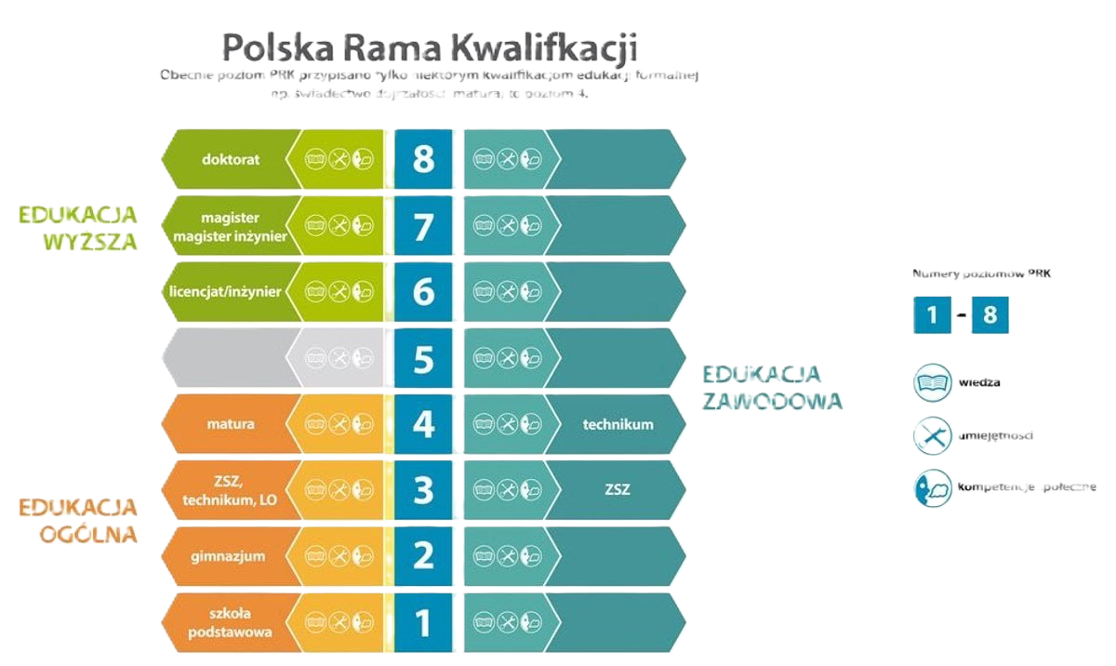
Education at level 5 of the Polish Qualifications Framework
„short-cycle studies”
(specialist education)
https://kwalifikacje.edu.pl/

Slide 23
Education at level 5
In polish law from 01 October 2018
Aimed at:
secondary school graduates;
working people who want to gain an education while improving their skills;
people who want to change careers;
people who want to learn a new profession.
Curriculum – focus on practical skills and vocational training.
Supports professional development.
Iasts 3 semesters (1.5 years).
Run by Universities of Applied Sciences
Responding to labour market needs.
It allows to obtain higher education, but not yet at bachelor's/engineer's level.
A bridge between education, vocational education and training, and higher education.
PAID education!!!.

Slide 24
FROM LEVEL 4 TO LEVEL 5 TO LEVEL 6…

Slide 25
Maturity exam*
or
vocational diploma
*Maturity exam - school leaving examination
Diploma of a certified specialist
does not hold a vocational diploma or secondary school leaving certificate
4. PQF
General
Technican
Post secondary
Vocational II level
5. PQF
Specialist education
(short-cycle studies)
6. - 7. PQF
Studies:
Bachelor’s degree
Engineering degree
Long-cycle Master’s degree
Certificate of completion of specialist education
possibility of recognition – confirmation of up to 50% of learning outcomes
shortened
study cycle
holds a vocational diploma and/or secondary school leaving certificate
Diploma of a certified specialist
Notes:
SCHOOL LEAVING EXAMINATION

Slide 26
Workshop
From Level 4 to Level 5 to level 6
– Does It Work in Europe?
https://prk.men.gov.pl/wp-content/uploads/2018/01/ulotka_dl_v06_druk.pdf pl/
https://kwalifikacje.edu.pl/

Slide 27
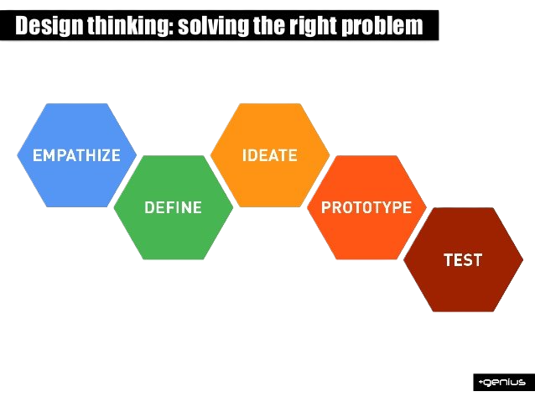
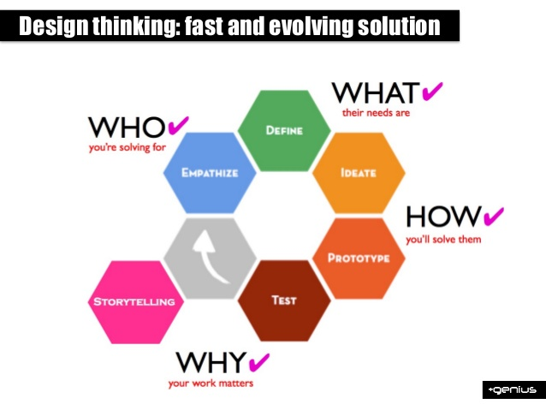
Design Thinking’s Phases
Notes:
Empathize: Understanding the user and the problems they face through conducting user interviews, creating empathy maps, and listening to user stories.
Define – your users’ needs, their problem, and your insights Define: Organizing and analyzing the research information to produce a concise problem statement and possible solution or hypothesis.
Ideate – The brainstorming phase. Designers think of a wide variety of possible solutions and evaluate each one.
Prototype – Turning ideas into a physical representation of the product that will solve the user’s needs, slowly adding greater detail and complexity as designers move between testing and iteration.
Test – solutions; Putting the prototype in the hands of the user and determining whether the product has solved the problem at hand and reduced friction or frustration.

Slide 28
Example: Inga, age 54
Empathize
Former retail manager laid off due to automation. Has not applied for jobs in over a decade.
„I feel like I’ve been left behind in this new digital world”.
She needs help to re-enter the workforce and find a meaningful second career.
Understand Inga’s needs, emotions, and context
Ideate
Generate ideas without judgment. Think broadly.
Brainstorming ideas:
Digital skills workshops tailored for 50+
Peer mentoring by other adults who successfully transitioned,
Confidence-boosting “re-entry bootcamp”,
Digital job search simulator or sandbox,
Employer outreach to recognize older talent,
Storytelling platform to normalize adult career transitions.
Test
Try the prototype with Inga or people like her.
Observe how Inga interacts with the workshop.
Gather feedback: What made her smile? What confused her?
Ask: What would make you feel ready to apply for a job now?
Measure confidence change pre/post.
Define
Clearly articulate the core problem Inga is facing.
Problem Statement (Point of View Statement):
“Inga is a skilled, motivated adult who wants to re-enter the workforce but feels excluded due to digital skill gaps and age-related biases. She needs personalized, respectful guidance to build confidence and navigate a modern job search.”
Prototype
1. A 1-week “Career Restart Lab” with:
  A hands-on session on job portals and email setup
  A peer group for shared stories
  Coaching on framing transferable skills
  “Practice applications” in a no-risk environment.
  2. Study on Level 5
Recognistion of prior learning (level of EQF),
Course or study on level 5????

Slide 29
Inga’s EMPATHY MAP
Empathy map is a visualization tool that allow to articulate what you know about users.
It is often considered a part of the design thinking methodology, and empowers to create a shared understanding of user needs and help decision-makers with key judgment calls.
SAYS | THINKS
DOES | FEELS
"I’ve worked all my life. I should still have value in the workforce."
"Everyone expects me to know how to apply online or build a CV from scratch."
"I don't want to start over, but I also don't want to be stuck."
"I feel like I've been left behind.„
"I'm too old to learn all this digital stuff.„
"I just want a job where I feel useful again."
INGA
Avoids online applications
Attends job center meetings
Occasionally browses job ads in newspapers
Tries digital tools but gives up quickly
Anxious about not having the right skills
Frustrated that her past experience seems overlooked
Hopeful but hesitant
Feels shame asking for help in digital skills
PAINS Feels left behind by digital transformation; Afraid of being rejected due to age | GAINS Gains digital confidence through hands-on help. Finds community and support from peers

Slide 30
Try to solve the problem…
Sara, Age 26 Background: Migrant from Syria with a degree in economics. Currently unemployed and navigating a new country and culture. Goals: Wants to work in finance or admin. Aims to regain professional stability. Challenges: Language barrier, non-recognized qualifications, limited local network, low confidence. Quote: "I just need someone to show me the first step." | Eleni, Age 47 Background: Administrative coordinator in a small family-run business for over 20 years. After the business closed during the pandemic, she’s been out of the workforce for 2 years. Volunteers occasionally to stay active and connected. Goals: Rejoin the workforce in a meaningful, stable role Challenges: Lacks confidence in interviews and job applications; Worries her age will be seen as a disadvantage Quote: „I’ve worked with people all my life — but I don’t know how to show that on a CV anymore”.
Johan, Age 18 Background: Recent high school graduate from a rural area. No plans for higher education yet. Goals: Wants to find work but is unsure of career interests. Challenges: Lack of guidance, limited job market exposure, peer pressure to "just get a job". Quote: "Everyone else seems to know what they’re doing—I don’t." | Tomasz, Age 37 Background: Dropped out of vocational training. Works occasional gig jobs and lives with family. Goals: Would like to return to education or find a stable job. Challenges: Low motivation, unclear pathway, financial instability. Quote: "I want to do something with my life—but I don't know where to start."

Slide 31
Let’s talk…
What should the Europe do in VET area on level 5 ???
Have you noticed that employers are interested in Level 5 graduates?

Slide 32
Thank you for your attention!
k.olszewska@ans-elblag.pl

